Slide 1

Smart Identity Management Platform Layout
Brittany Jacques, Debolina Mukherjee, Glenn Kees, Jaime Barragan, and Paul Rodriguez

Slide 2

Hypothesis
Identification of an individual or an asset is key for recognition. In today’s world of digitization, the most efficient way of having this record is in a digital form as well as to save ourselves from the potential issue of Identity theft. Smart Identity is a solution which will allow users to create a universal digital identity powered by blockchain technology.

Slide 3

Motivation & Summary
By leveraging the security, anonymity, flexibility, and decentralization of a Smart Contract, Solidity allowed us to build a non-fungible token which can store essential and private as well as non-private identification elements, including the ability to store documentation.

Slide 4
Motivation & Summary Cont.
We leveraged the Web3 network using Python to communicate dynamic inputs and character fields back and forth to Solidity for constant streamlined read-only capabilities in the blockchain smart contract to then be stored in a wallet using the Pinata client.

Slide 5
Motivation & Summary Cont.
When the transaction is stored in the blockchain, it can be intentionally identified and retrieved for any purpose, so long as the user intends to use it. Examples of use include passports, driver’s licenses, social security cards, credit cards, medical documents, registrations, wills, physical contracts, checks, financial documents, among many others.

Slide 6
Motivation & Summary Cont.
Finally, we used the Streamlit data script editor to create an interactive and user-friendly method of interaction between them and the SIMPL decentralized application that presents a fluid format for efficient completion

Slide 7

Model Summary
Smart Contract/Token Creation Tool: Solidity
Storage/Wallet: Pinata Client
User-Interface Creation Tool: Streamlit
Smart Contract/User-Input Backend Communication Tool: Web3 via Python

Slide 8
Model Summary
Four main pieces of information collected
First name, last name, date of birth, and social security number
Key feature: secure storage of documentation to token
Can be stored in any crypto wallet, easily accessible and highly secured

Slide 9

Data Exploration & Clean up
fefefgf

Slide 10

Findings & Discussion
grtsgr

Slide 11
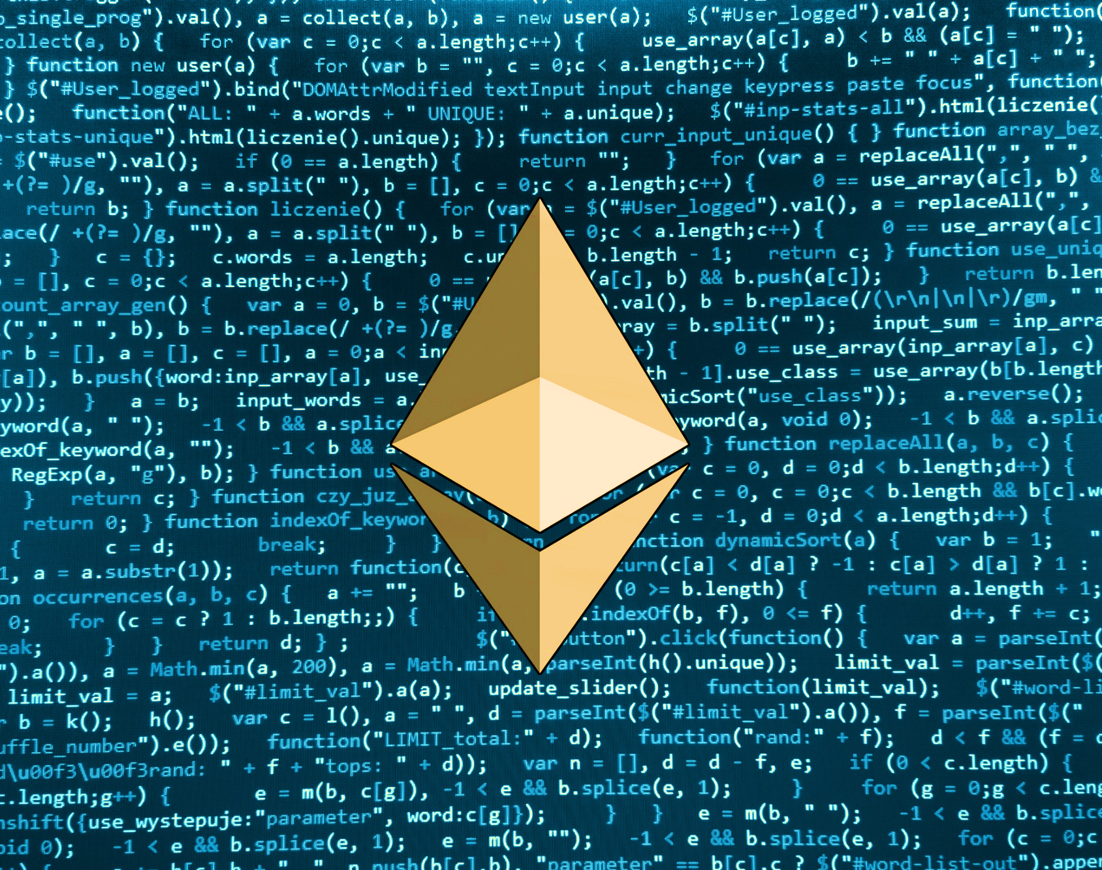
Postmortem

Slide 12
Postmortem (Limitations)

Slide 13
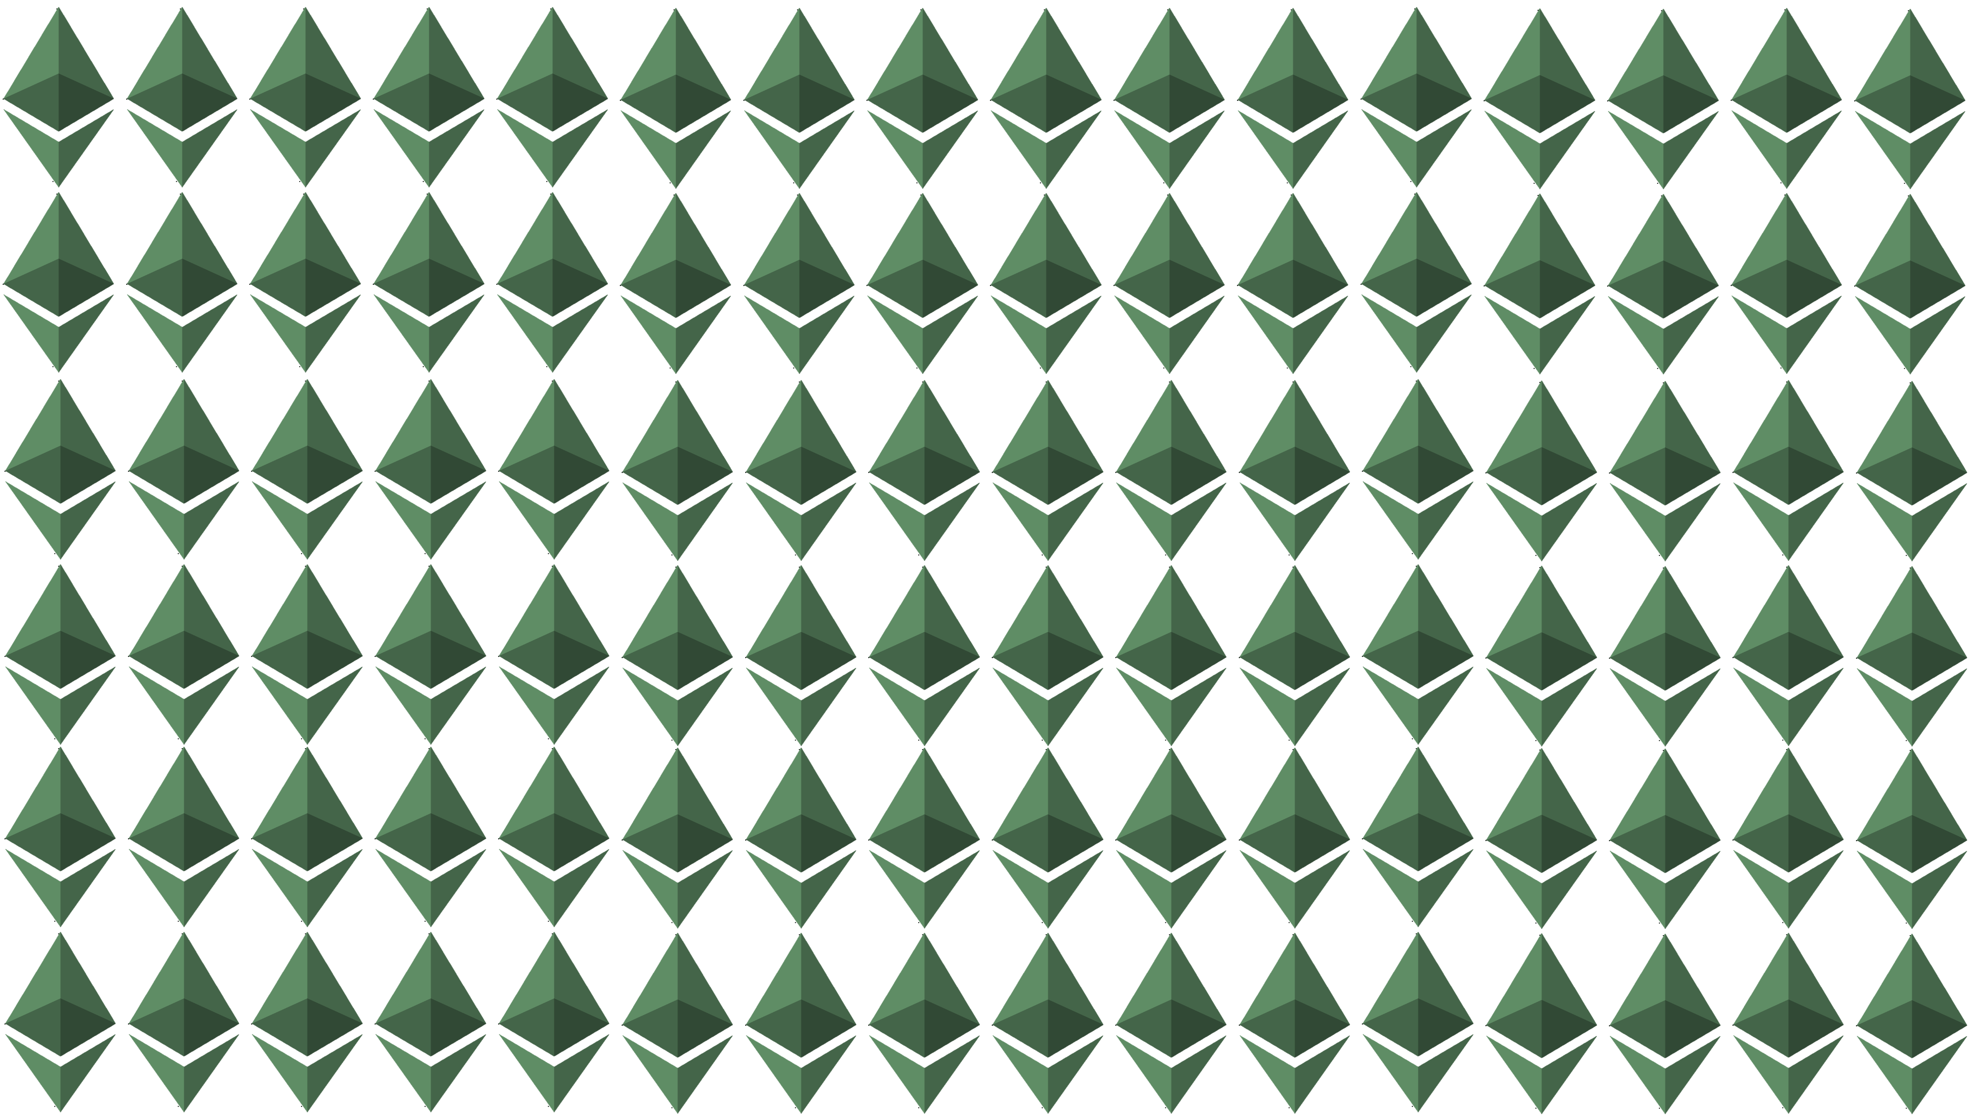

Questions

